Slide 1
Grapher/Explainer

Slide 2
Instructions
Sit with a partner, shoulder to shoulder.
One person faces the board, the other person faces away.
The person facing the board will be the explainer.
The person facing away will be the grapher.

Slide 3
Your goal
I will be listening for active use of English and Math Vocabulary
The goal is to replicate the diagram as accurately as possible

Slide 4
Practice Round

Slide 5
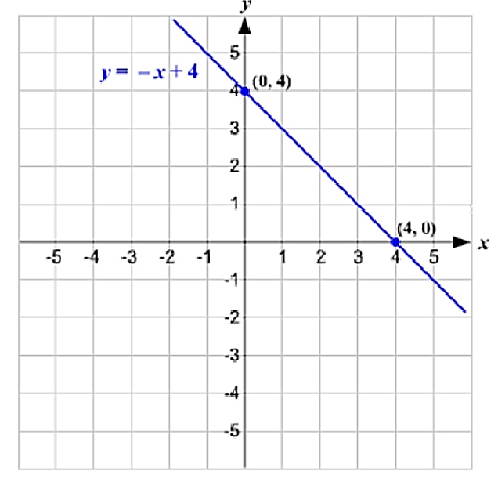
Solution

Slide 6
#1

Slide 7
#2

Slide 8
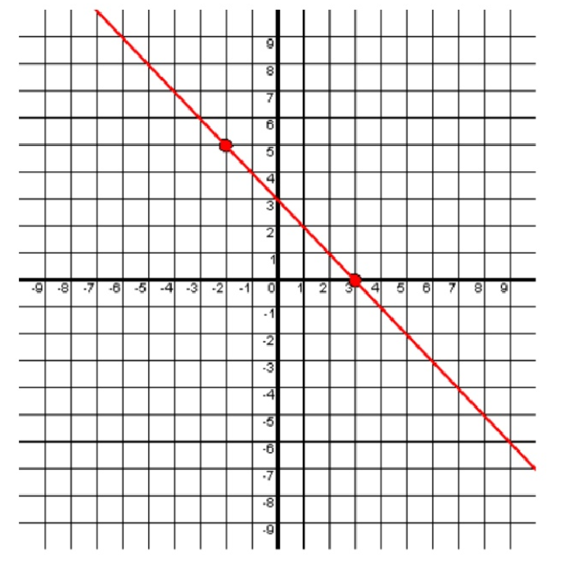
#3

Slide 9
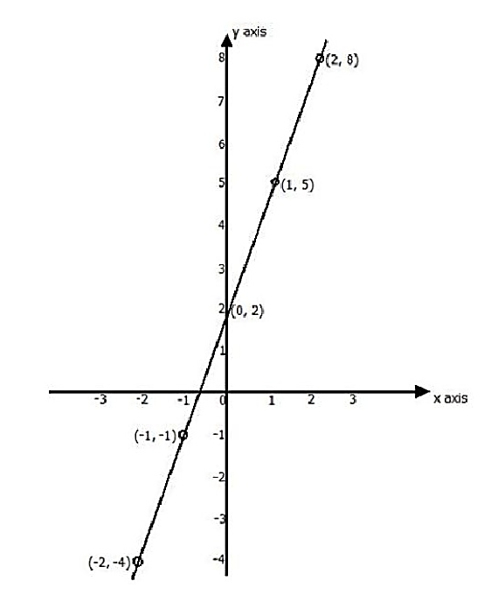
#4

Slide 10
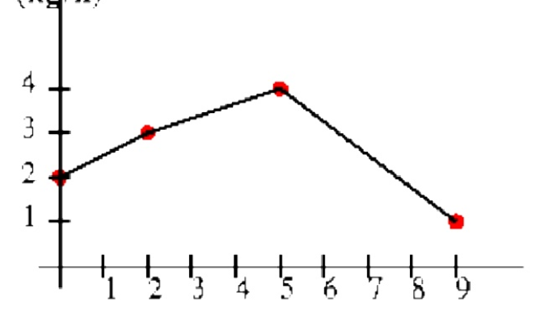
#5
Distance (m)
Time (min)

Slide 11
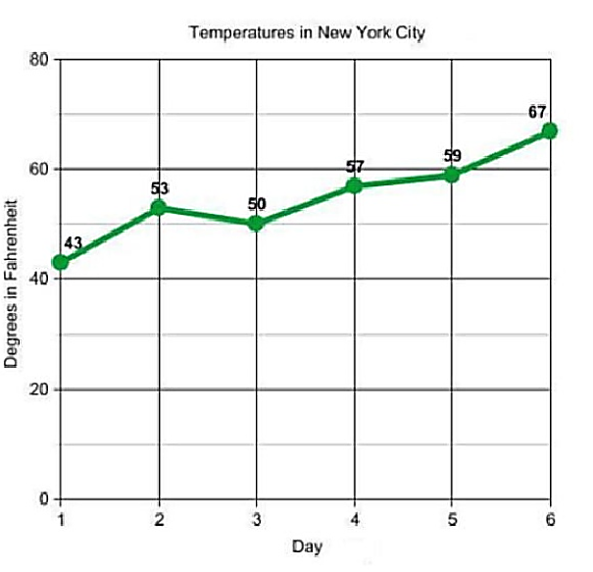
#6

Slide 12
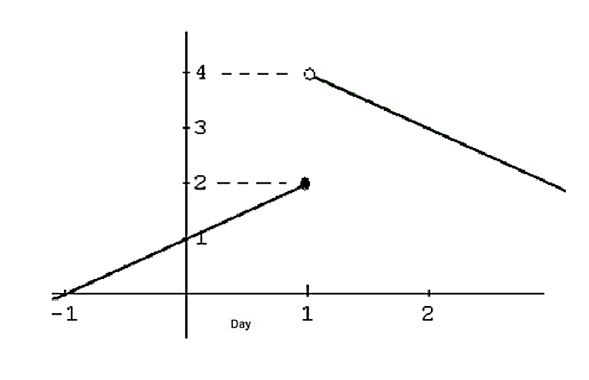
#7

Slide 13
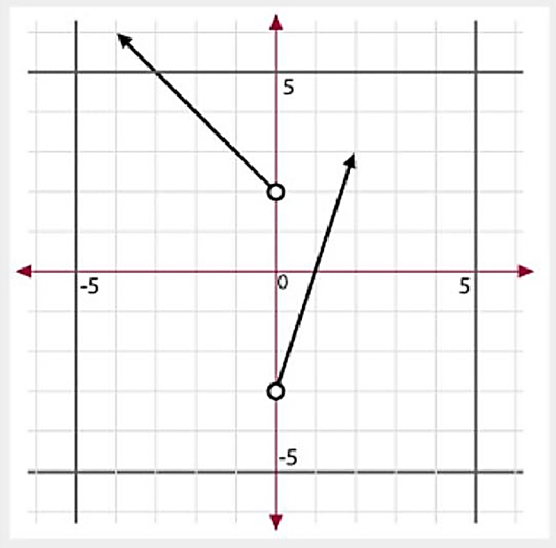
#8

Slide 14
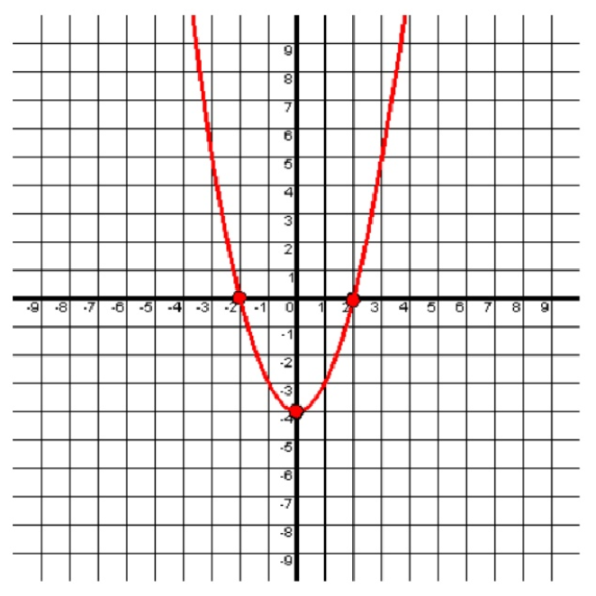
#9

Slide 15
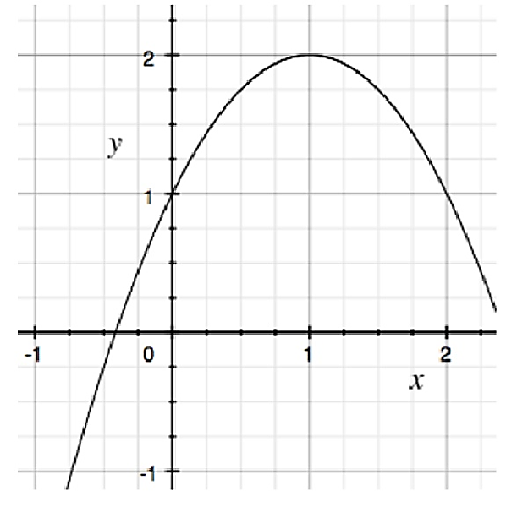
#10

Slide 16
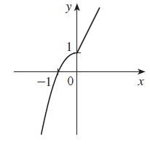
#11

Slide 17
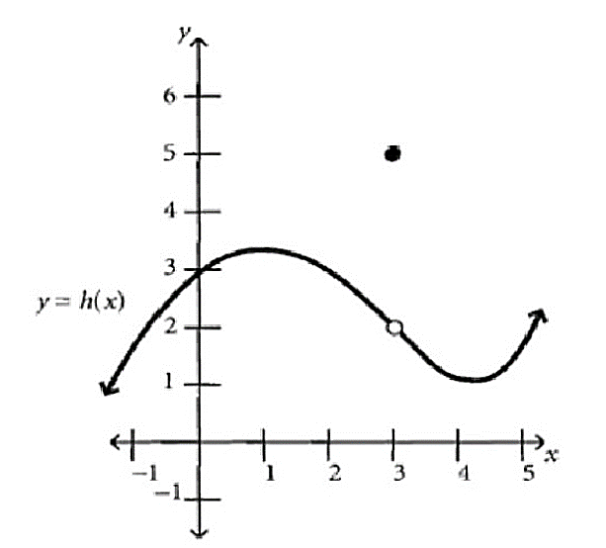
#12

Slide 18
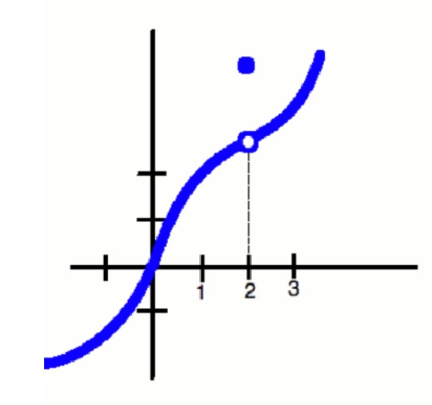
#13

Slide 19
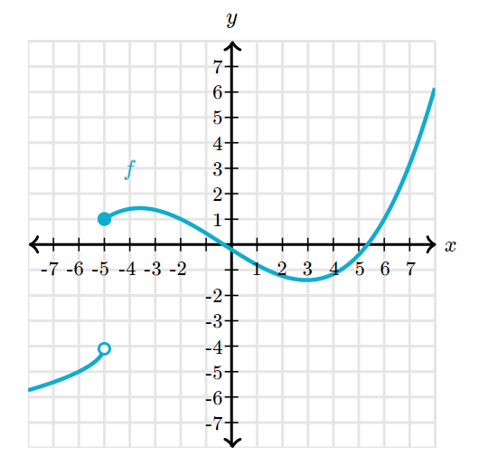
#14

Slide 20
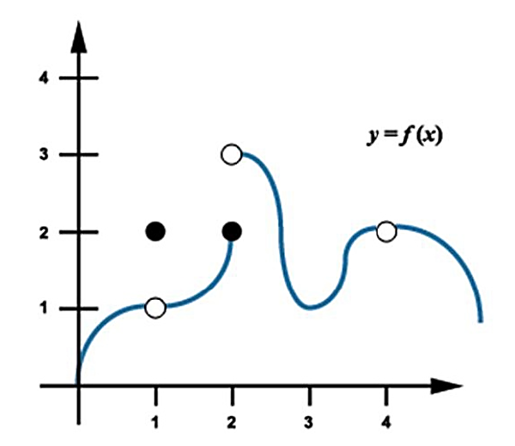
#15

Slide 21
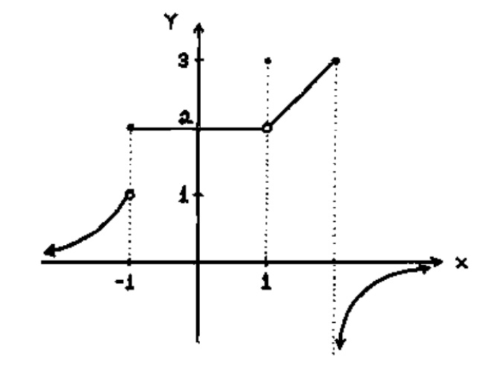
#16

Slide 22
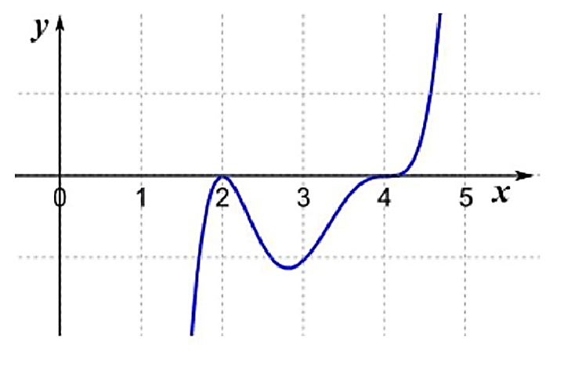
#17

Slide 23
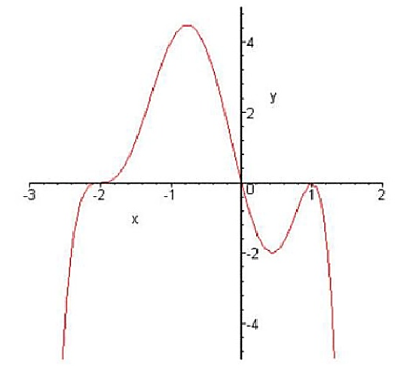
#18

Slide 24
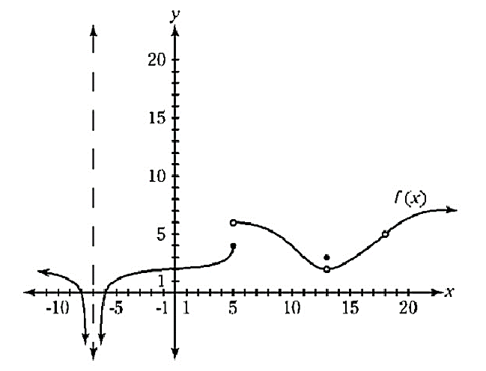
#19

Slide 25
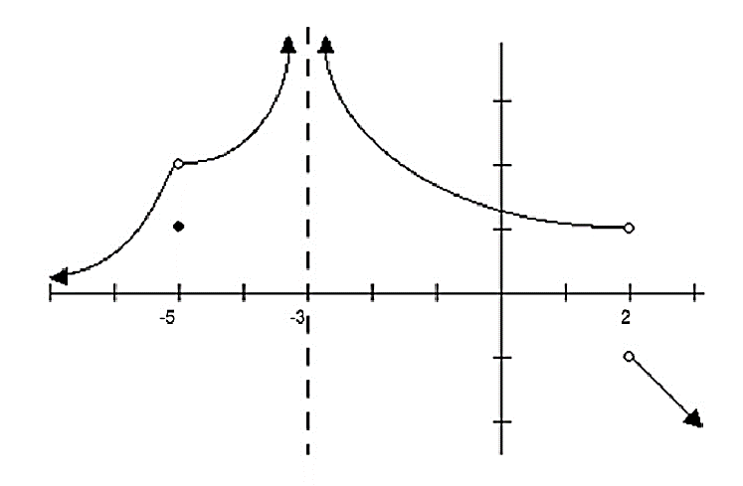
#20

Slide 26
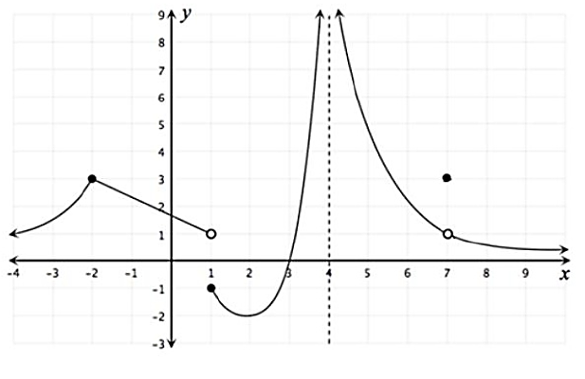
#21

Slide 27
Challenge
Draw a graph that meets the following criteria:
The point (-3, -1) is on the graph.
The point (0,1) is on the graph.
The point (0, 1) is on the graph.
There is a hole at (0,2) and the graph continues left and right from that point.
The point (2, 0) is on the graph.
There is a jump discontinuity at x = 2. The graph continues left from (2,1) and right from (2, -2)
Neither of those points exist
There is a horiztonal asymptote y = -1 for x > 5
There is a vertical asymptote at x = 4, both sides increase towards $+∞$

Slide 28
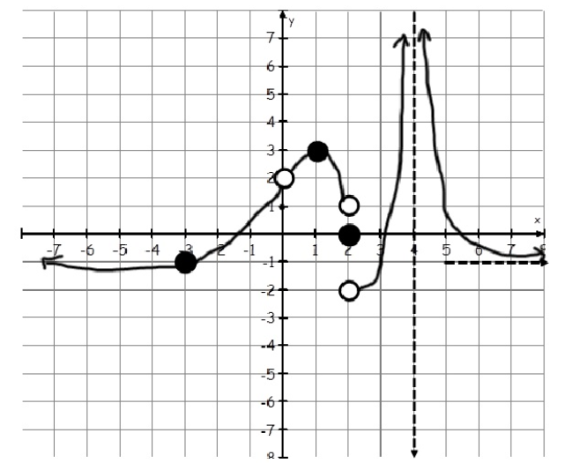
The solution

Slide 29
Reflection
What descriptions were given for the graphs?
What could have been said to make it easier to graph?

Slide 30
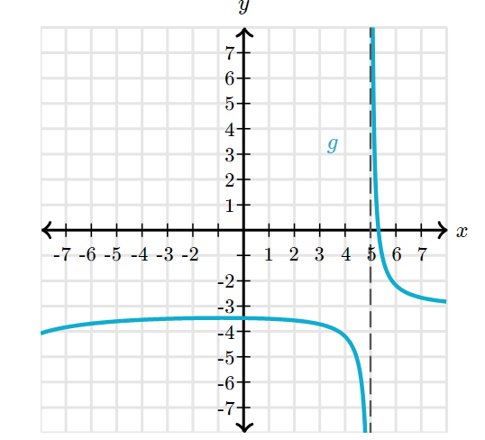
Exit
Write a detailed description for the following graph:

Slide 31
Reference
https://blogs.cofc.edu/owensks/2012/08/22/first-day-activity/comment-page-1/

